Slide 1




Industrial Economics Project
Group X
The Football Industry:
A Global Value Chain Analysis
on the Procurement of Players

Slide 2
The Football Business
What is it about?
Football has an estimated number of 3.5 billion fans across the globe, 43% of the population.
Its market size is at least worth $3.1 billion, with a CAGR of 5.82%.
Football clubs have become prominent multinational enterprises, capturing fans from all the diverse socioeconomical backgrounds; nonetheless, its original lower class fan base, still substantially constitutes the nucleus of loyal customers for the business.
The level of personal, social and cultural influence, combined with its scale, has attracted important investments to exploit these opportunities. Now clubs have become much more complex organizations, each potentially pursuing different interests, ranging from the natural opportunities for economies of scope, to the political influence of the Sport.

Slide 3

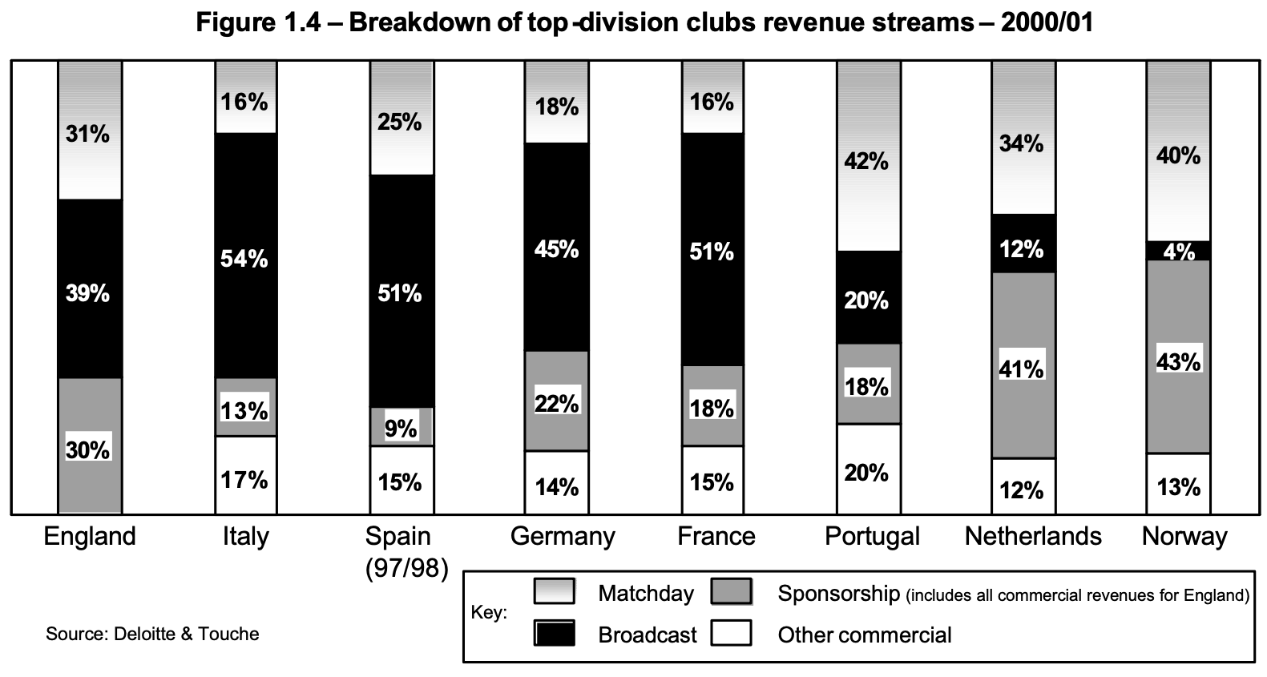




The Football Business
Which Actors Are Involved?
Matchday Services: Food & beverages, Restaurants, VIP programs, tickets etc…
Sponsorships: Main sponsor, Fashion sponsor, Car sponsor etc.
Broadcast: Sky, DAZN, Rai, Mediaset etc..
Other Commercial

Slide 4
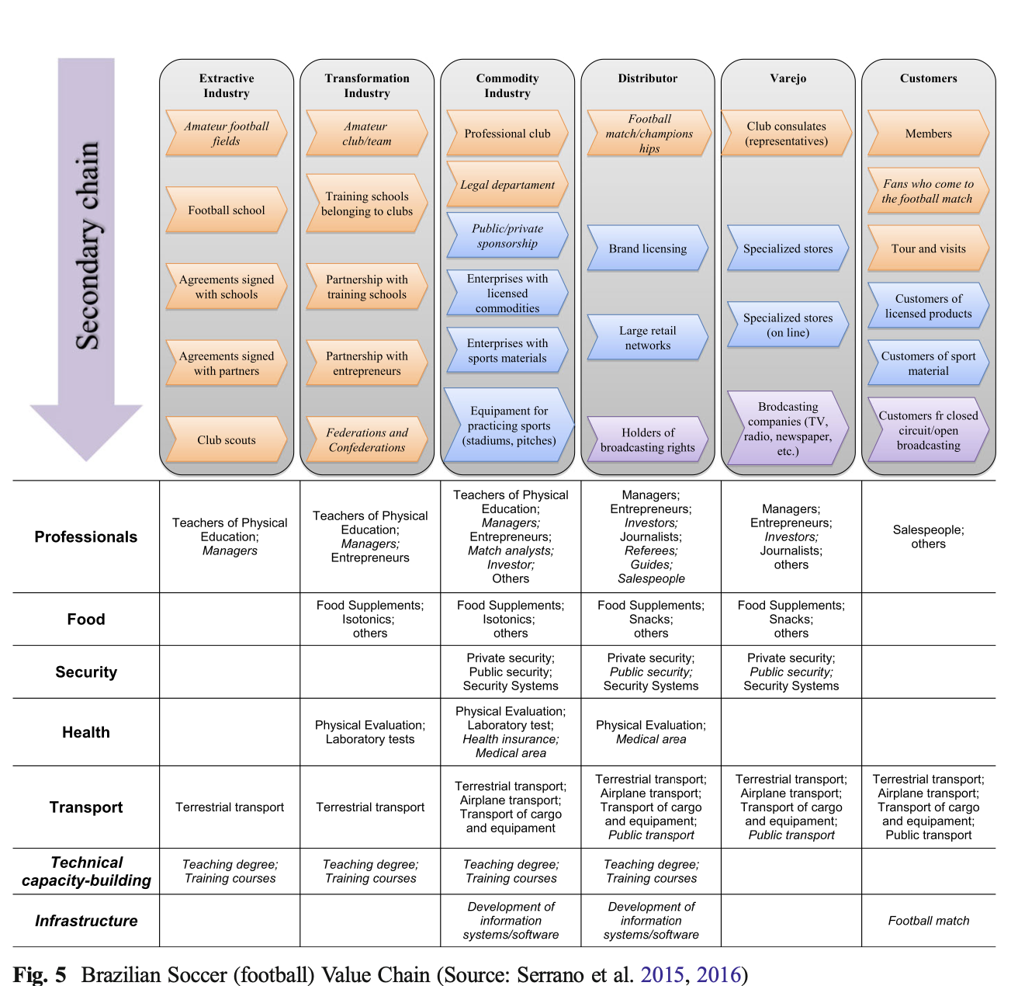
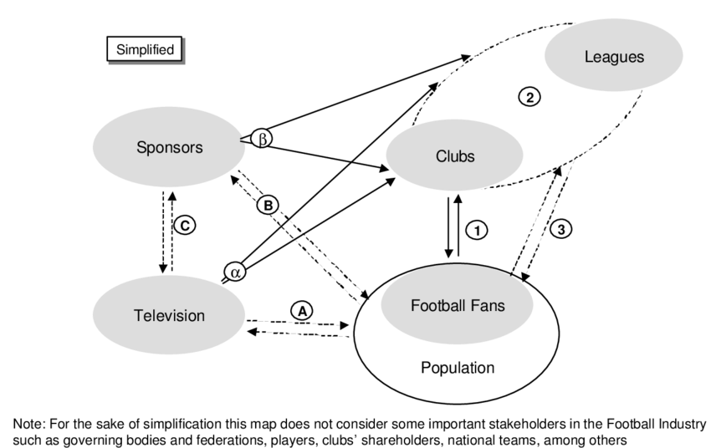
The Football Business
The Complex Global Value Chain

Slide 5
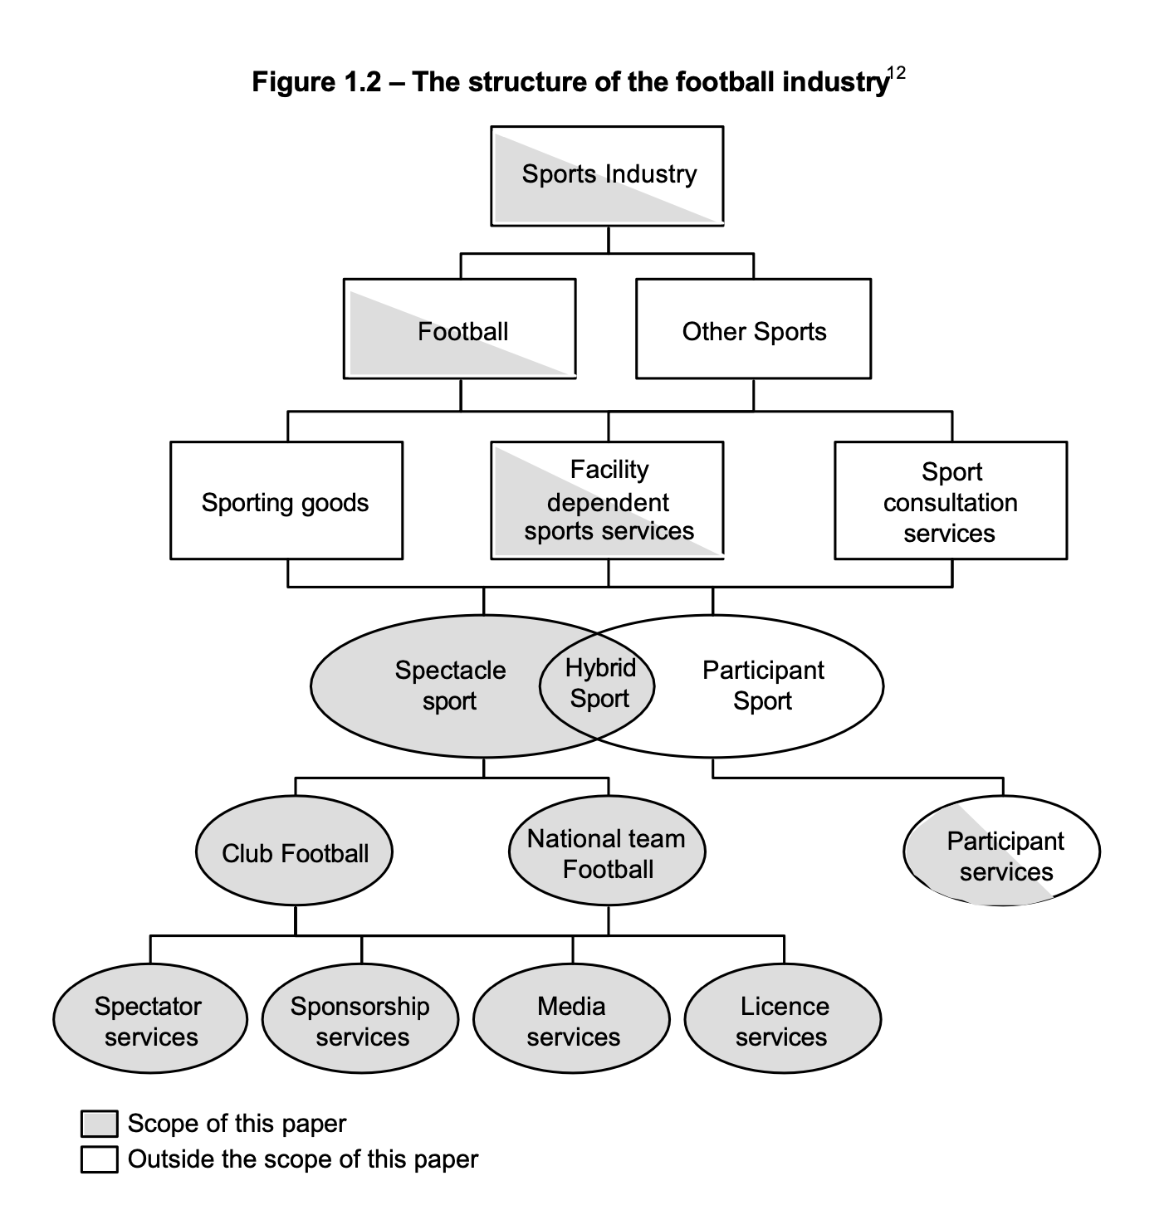
The Football Business
The Object of Analysis

Slide 6
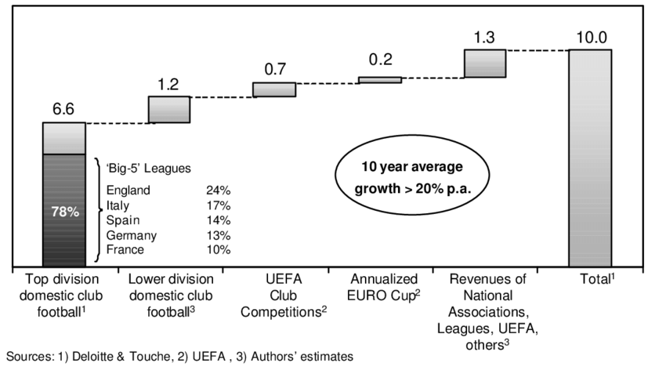
The Football Business
Ways to acquire a new player: a Footballer’s journey
Age 0-11
Age 12-18
Age 19 -
Investors
- The best Academy players go to the first teams
- Kids start playing
- Talent starts emerging
- Sport’s
Promotion & Culture
- Kids train in football schools
- Others get sold or loaned to make experience
- The best get selected for Top Club’s Academy
- The Club sells/buys players every year, during the winter and summer windows
Government
- The others populate lower-level leagues
Government
&
Investors

Slide 7
The Football Business
Value Added Curve
Classic Value-Added Curve
Value Added
Modern Value-Added Curve
Extraction-Transformation
Sporting Team
Marketing & Commodity

Slide 8
The Football Business
Football clubs: how do they compete?
Each football team can be split two parts: The staff, with the manager included, and the Football Team.
We will focus on the Football Team, and, in particular, to the Procurement of Football players.
Therefore, we will now focus on the main two ways you can procure a player, being a Football Club: Youth Academy & Market Transactions.
IMPORTANT: We will consider Football players as Assets. It is a special case, because usually human beings are considered as Labour, and are recognized certain rights. In the Football Industry, Clubs own the Football player: from their performance and for the rights of use of their image. They are booked as assets, and treated as such even economically.

Slide 9
The Football Business
KEY
Football’s Relational Global Value Chain Governance
Promotion from Academy
Promotion through Agent
Transaction with other clubs
Purchase of Free Agents
2
Club 1
Club 2
Sports Director
3
Sports Director
First Team
First Team
4
Player’s Agent
Player’s Agent
Academy
Staff
Academy
1
Academy
Scouts
PR
Low ability to codify
Target Player
Target Player
High Capabilities
Target Player

Slide 10
The Football Business
Football clubs: how do they compete?
Investments in Youth Academy Transactions and are hard to measure. The cost of players is rather low, the relevant investments in the academy are usually sports facilities and equipment to train young players. These expenses are difficult to retrieve and analyze due to the scarcity of disclosures, since a substantial number of clubs are private. The available invoices are either clearly booked as academy expenses, or, in most cases, it is materially impossible to disentangle the value of the specific investment for the Academy, from the overall value brought to the whole club.
For transaction type , the Agent World is very complex and even harder to analyze. Due to their crucial role, and the rising Agent rents (we will later partially visualize this phenomenon), the biggest international body, Fifa, has tightened the laws ruling the Agent capabilities.
1
2
4

Slide 11
The Football Business
Data Analysis Introduction: Type 3
3
Object of research:
Is the “natural nearshoring” increasing or decreasing over-time?
What’s the relationship between the leagues of different countries?
What is the difference between the different leagues and their relative Bargaining power?
Methodology:
Used open-sourced platforms for the Players Datasets and the Transfers Dataset
Processed data to produce graphs and regressions
Coded in Python, we used an Object Oriented approach to store data, to render our analysis easily replicable. Click here to access the full GitHub Repository of the project.

Slide 12






The Football Business
Natural Nearshoring
1978-2002
1954-1978
1930-1954
1906-1930
1858-1882
1882-1906
Football has always been a
People’s sport, and therefore
there has always been
an excess of supply.
Here a slideshow of the
log density of Serie A players
born in each era.
Is the trend changing? Will there be more offshoring?

Slide 13
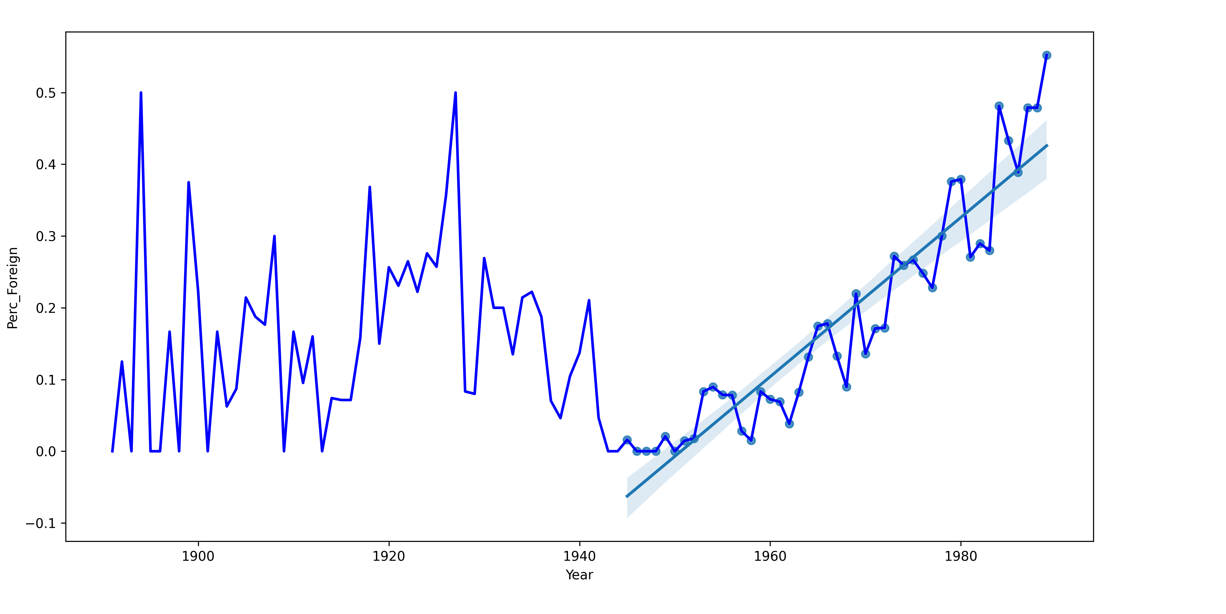
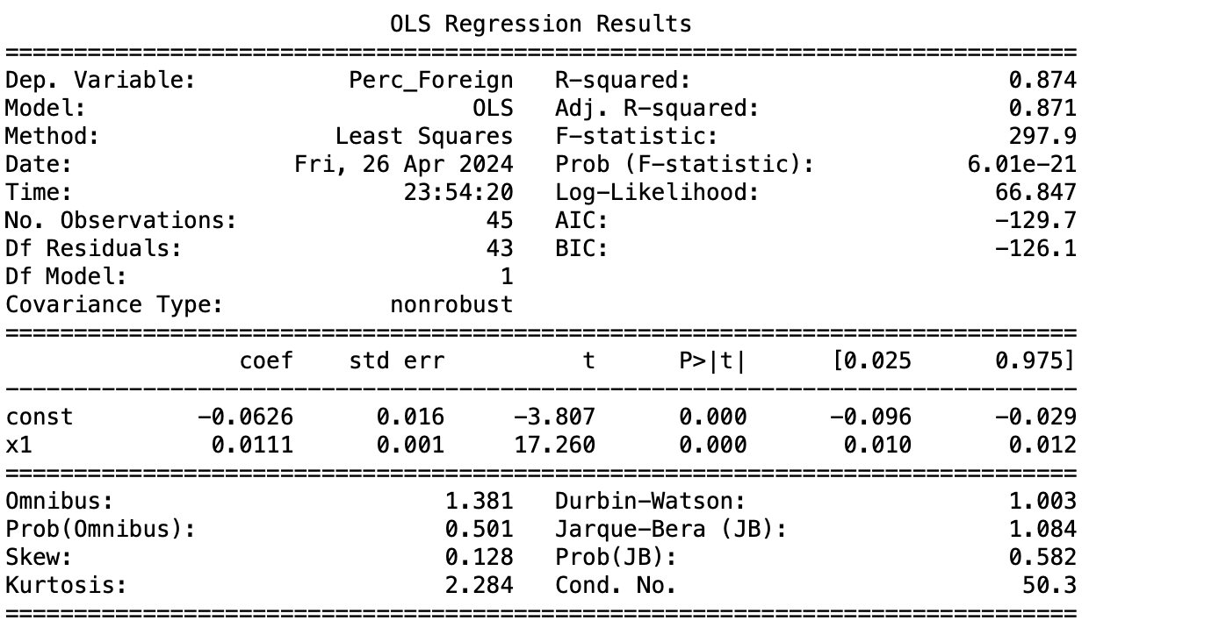
The Football Business
Natural Nearshoring
We can also perform a regression.
X: Player’s Year of birth
Y: Percentage of foreign players in the league
For a player born in year n, the next year (n+1) he will play in a league with the proportion of Foreign Players increasing by 1.1%.

Slide 14
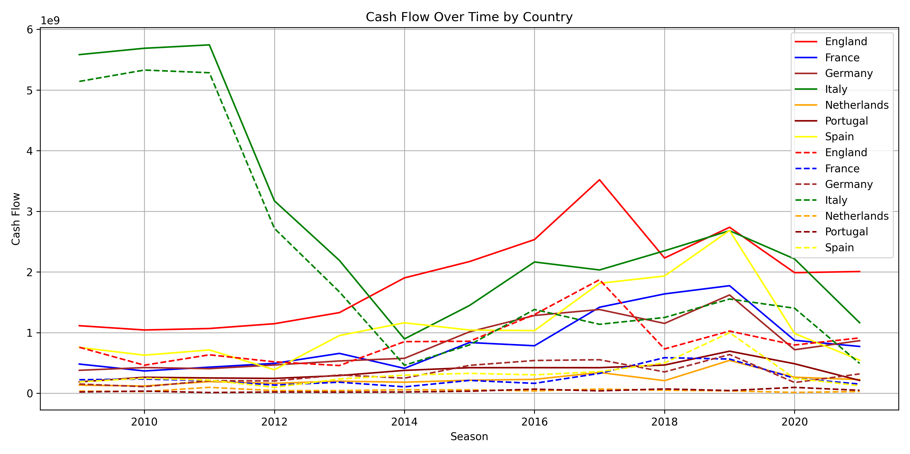
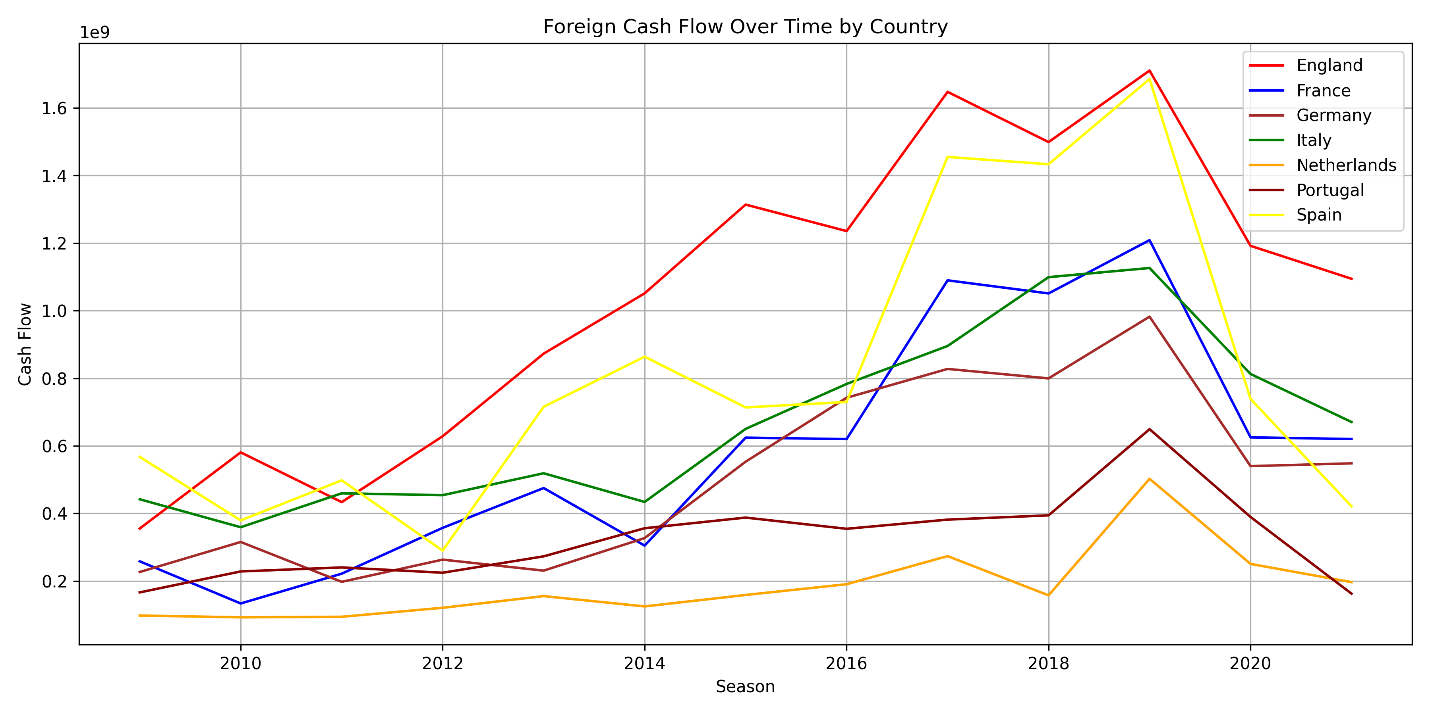
The Football business
How much cash flow does a league generate from transactions with Foreign Clubs? Local vs Foreign
We were only considering nationality, but what about the country from which players are supplied?
Cash flow Analysis
Average yearly cash flows: $9 bn

Slide 15
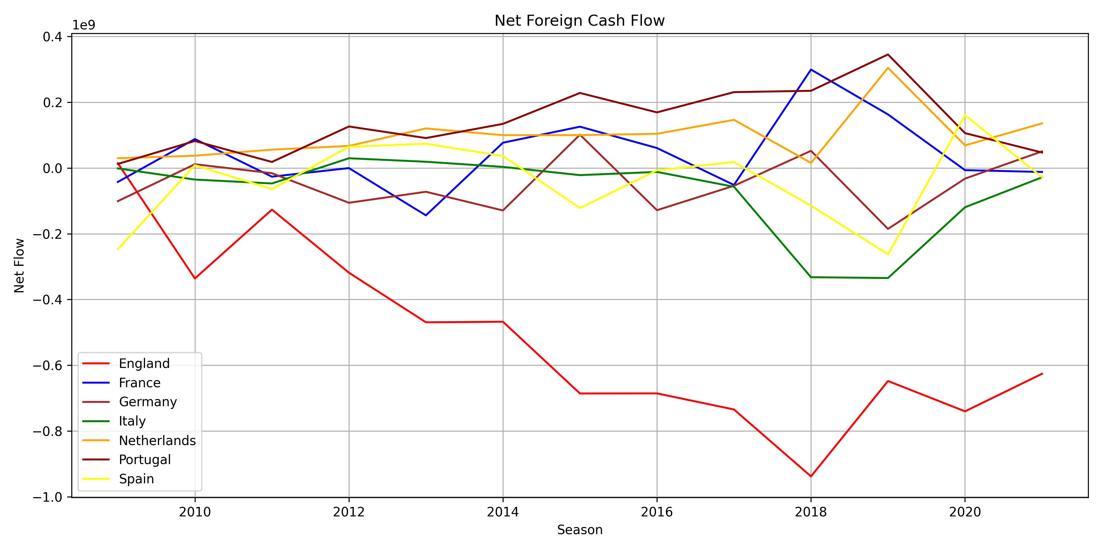
The Football business
How much cash flow does a league generate from transactions with Foreign Clubs? Local vs Foreign
Positive means
less outsourcing, but also signals weakness.
Negative means
more outsourcing, but also signals strength.

Slide 16
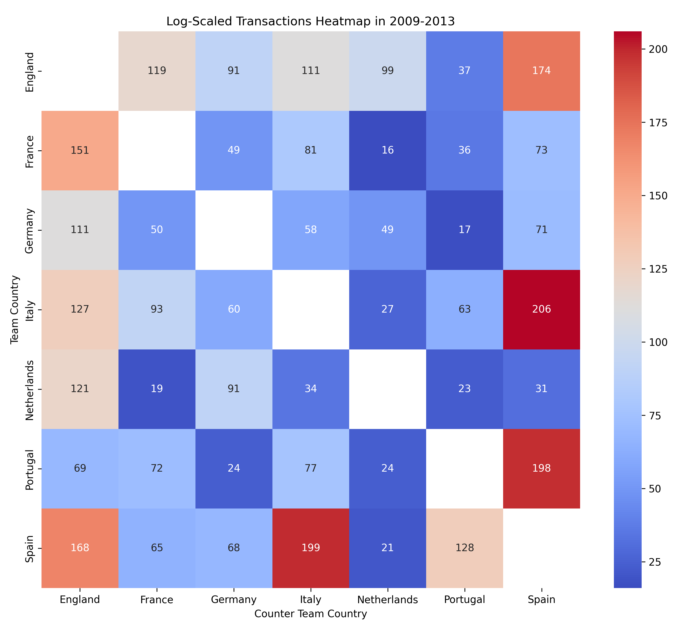
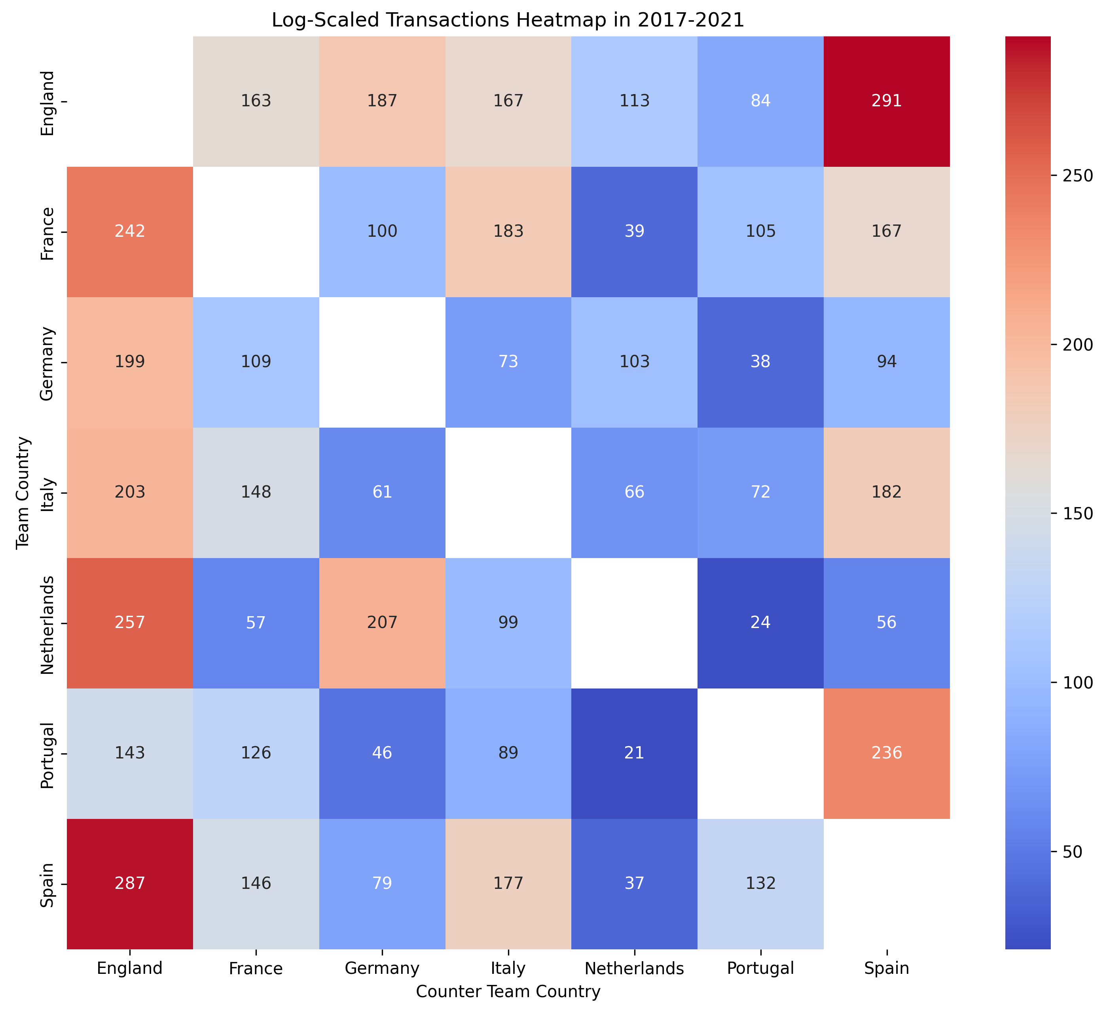
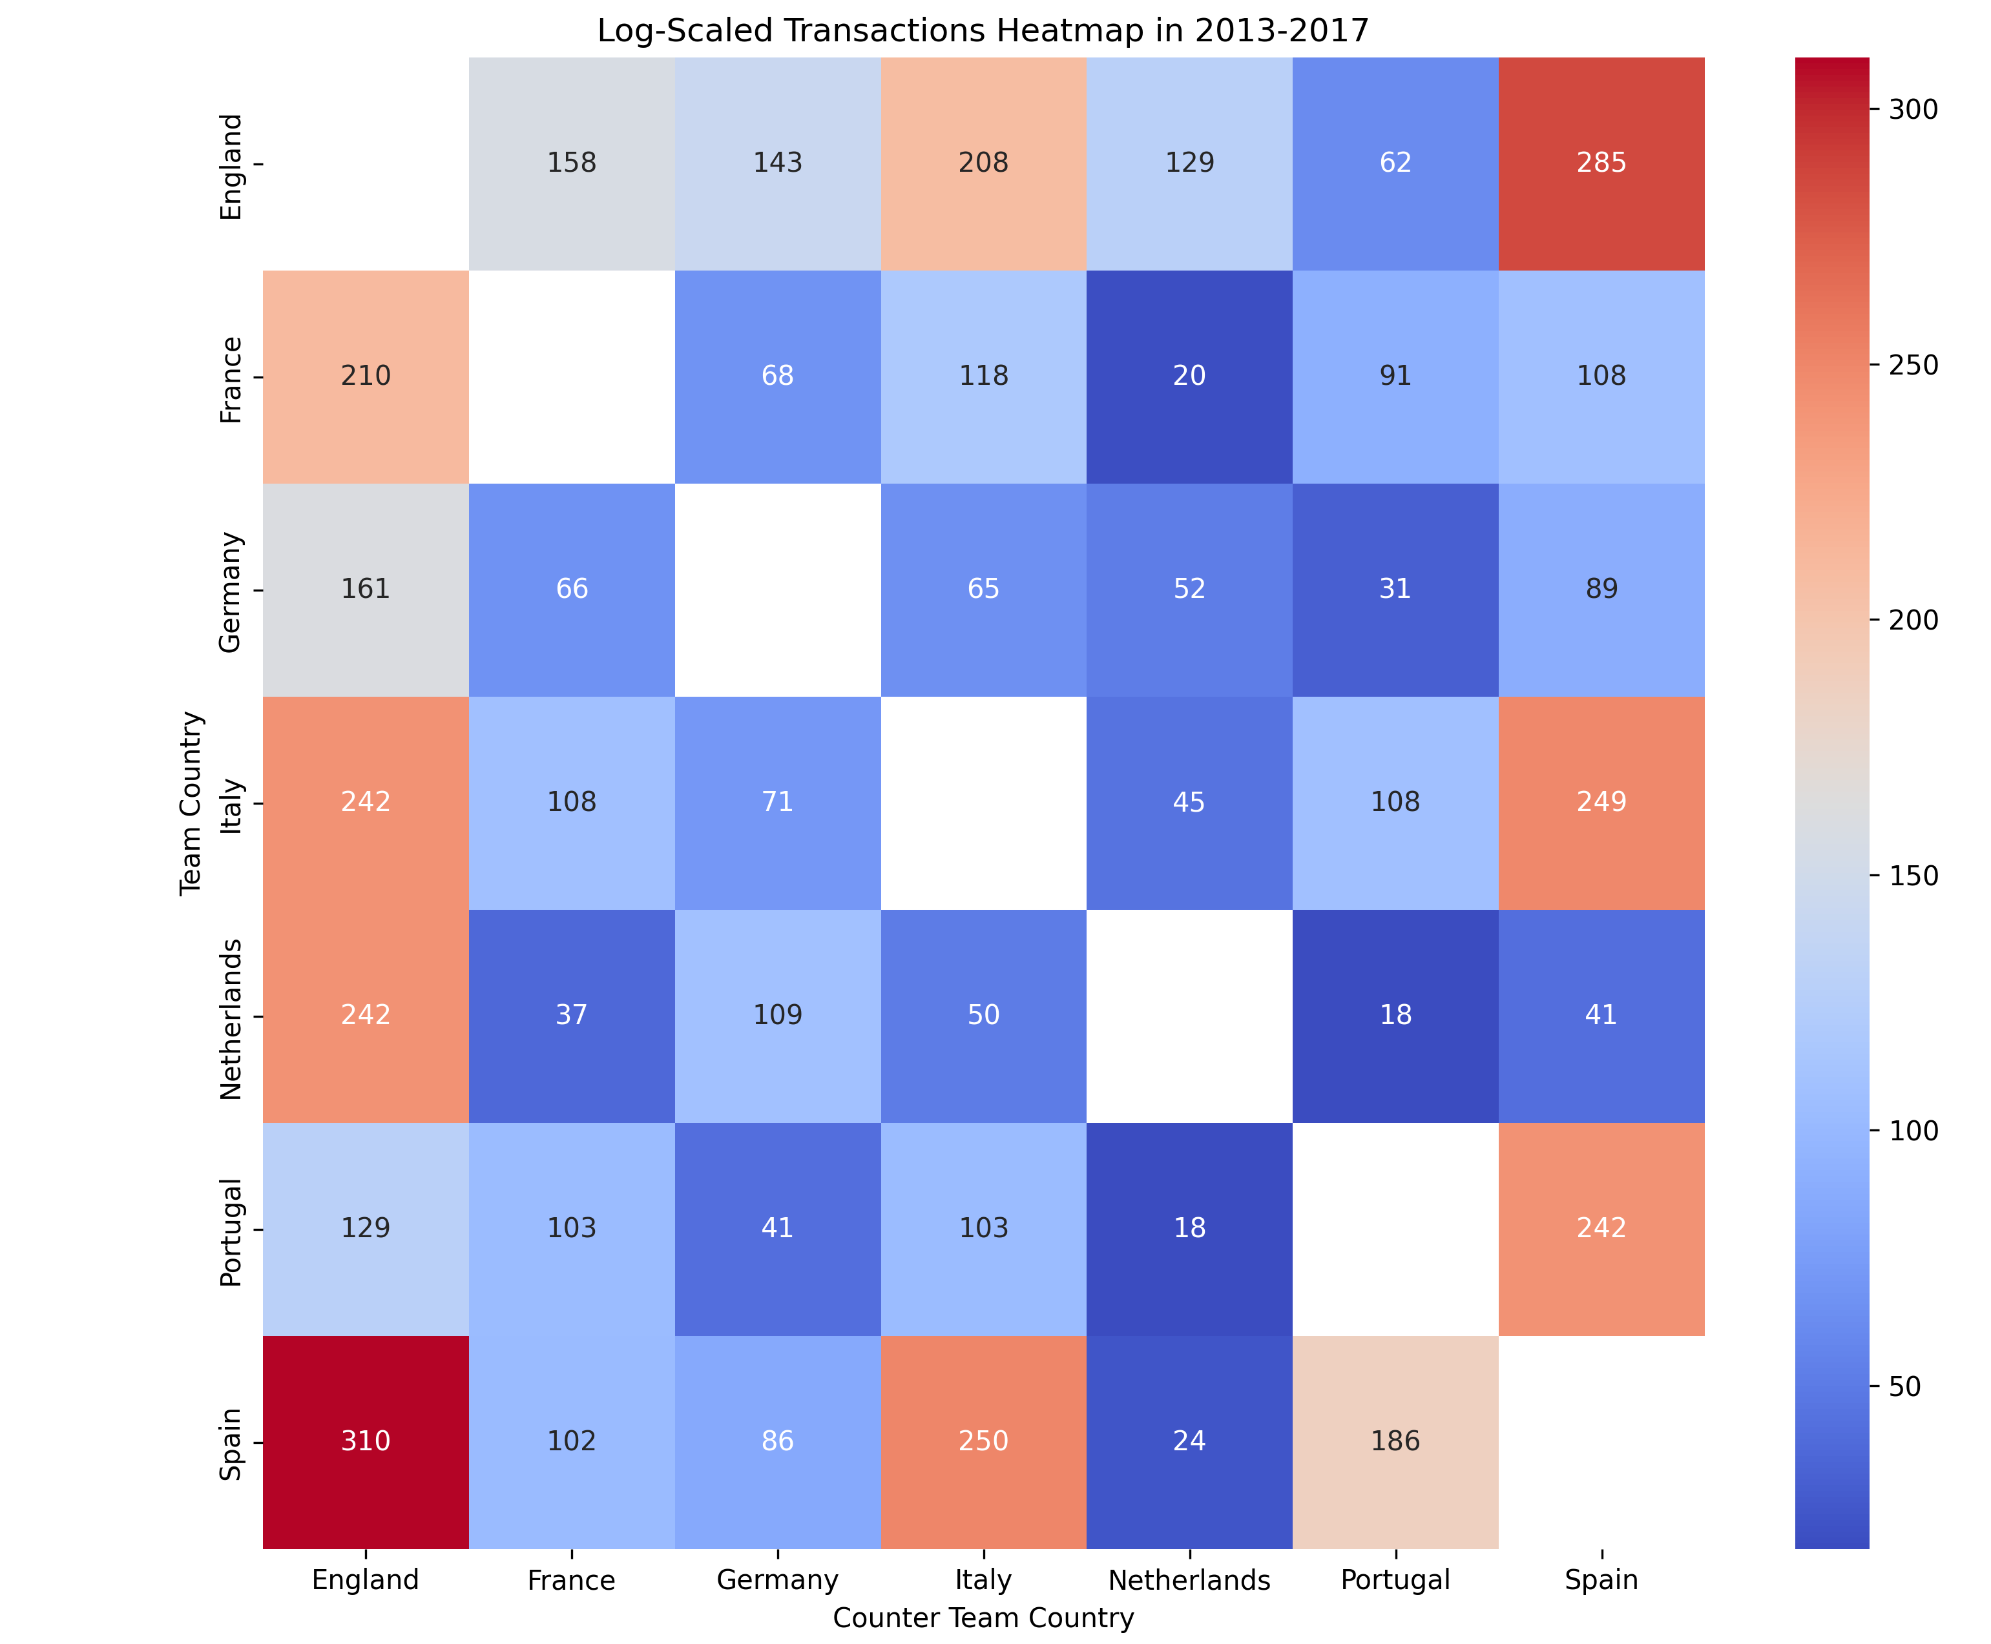
The Football business
Which are the biggest Partners for each country?
This heatmap shows, in three different year ranges, how many transactions were performed between clubs of different leauges.
- Each cell box represents transactions from a country in the left column to a country in the bottom line.
Read row-wise, each row represents how many foreign purchases are made by a country.
- Read column-wise, each row represents how many players are bought from a country (Attractiveness & Level of the league).

Slide 17
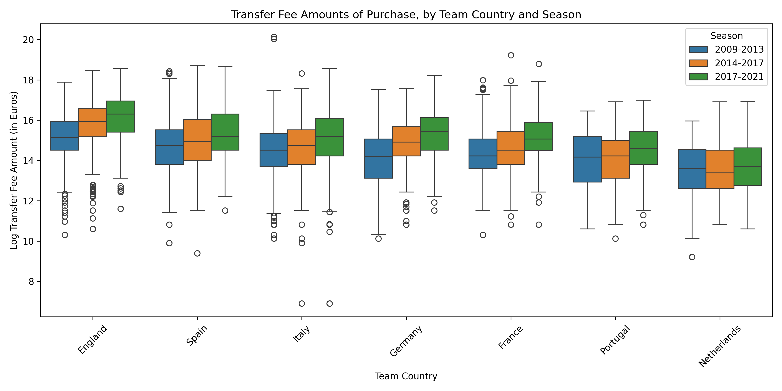
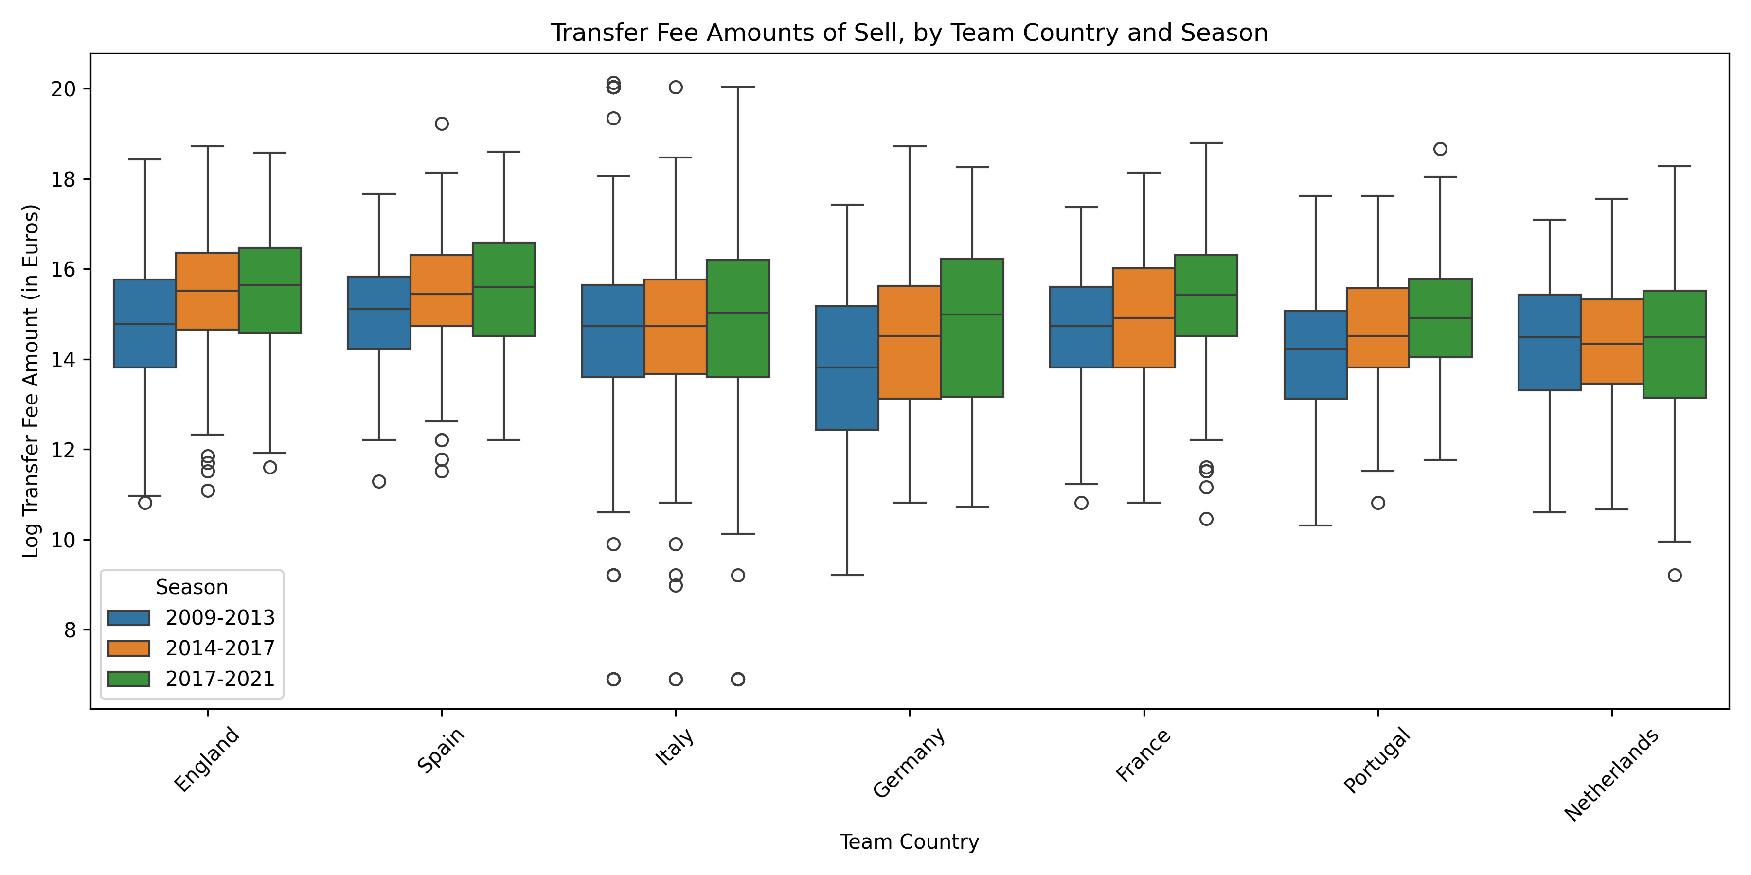
The Football business
Expanding on league’s Attactiveness

Slide 18
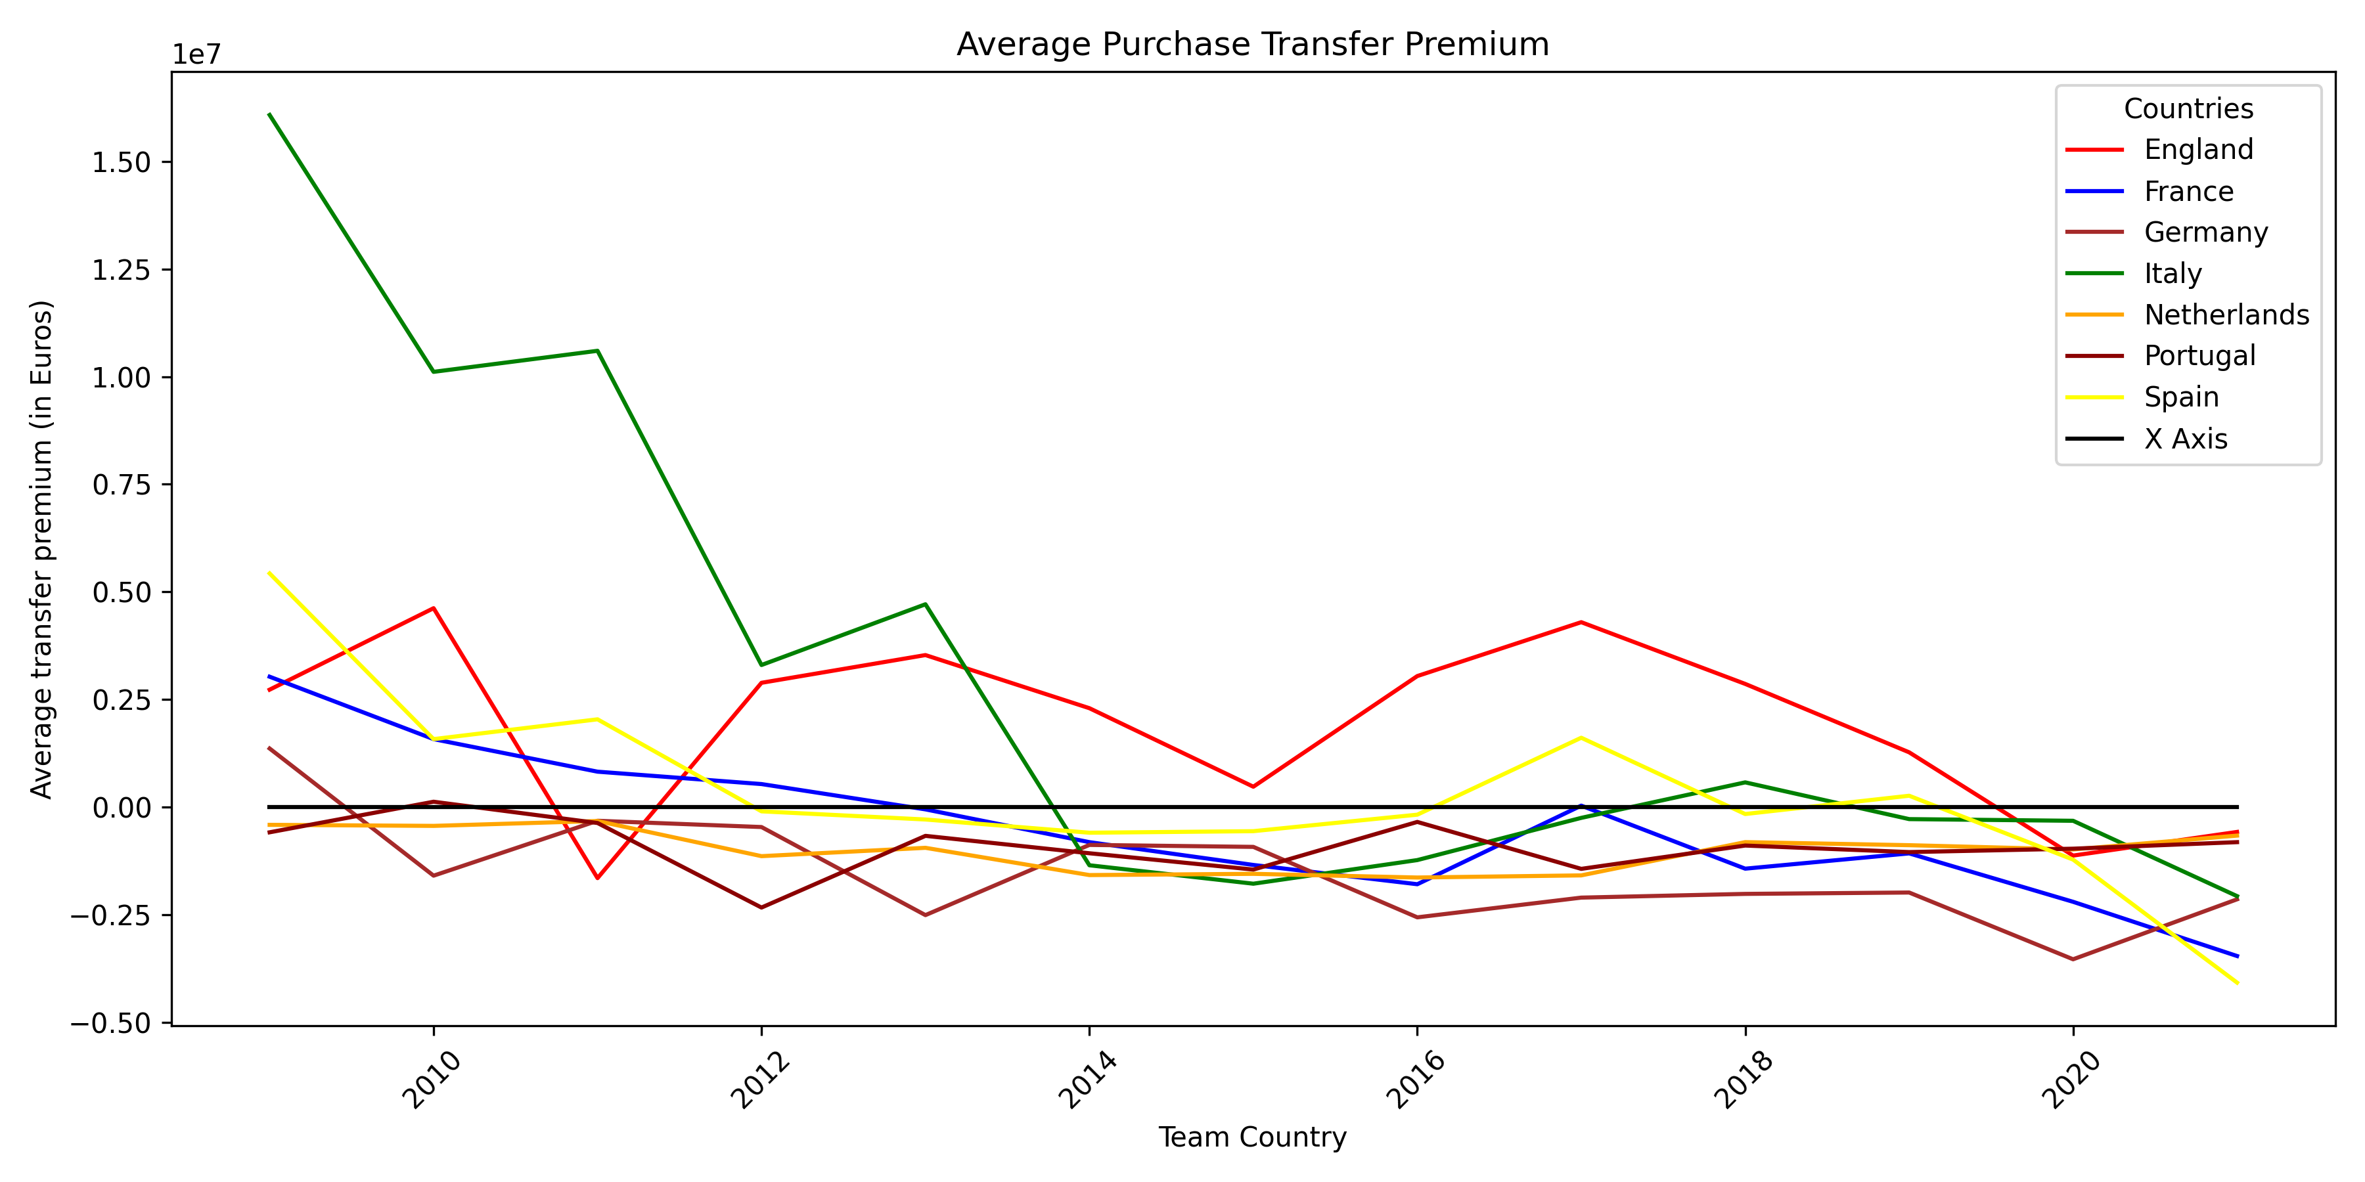
The Football business
Transfer Premium

Slide 19
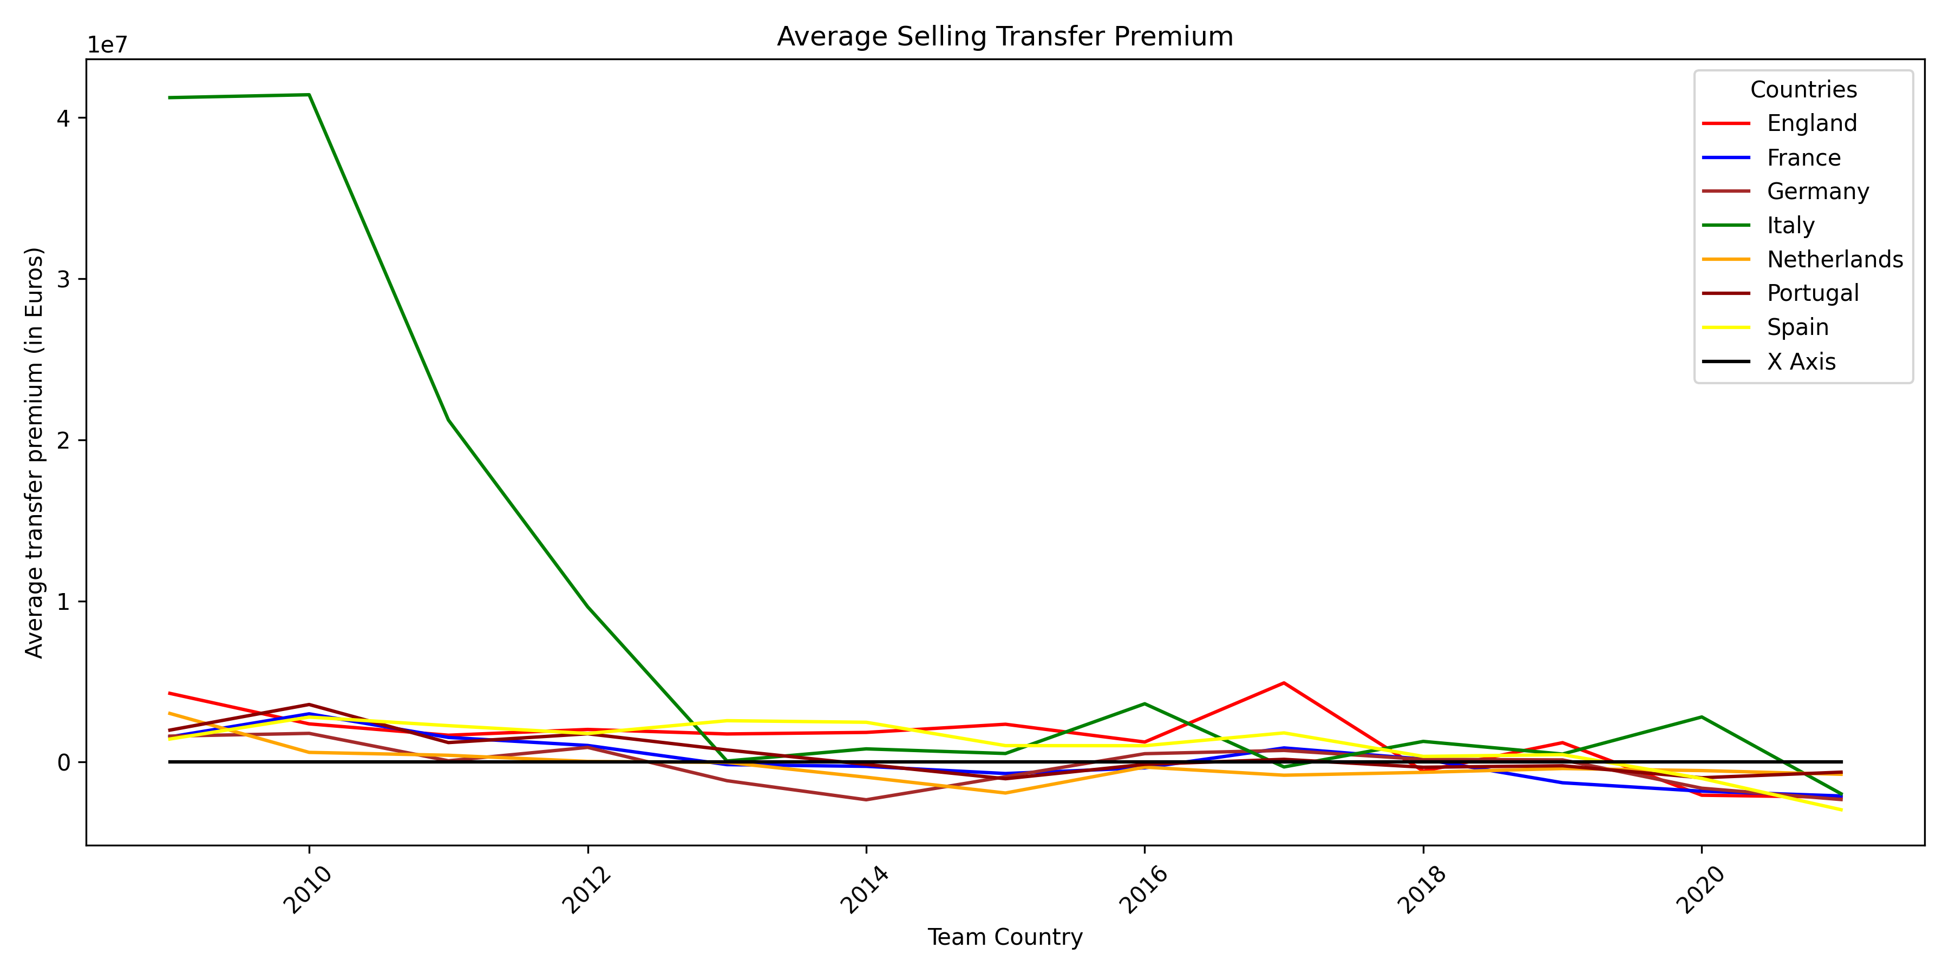
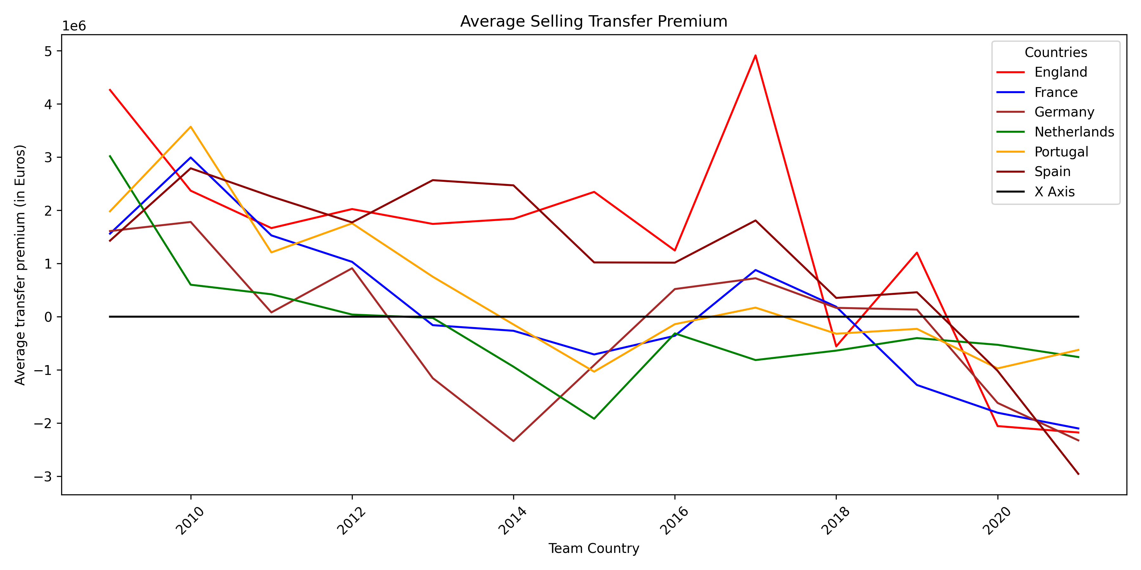
The Football business
Transfer Premium

Slide 20
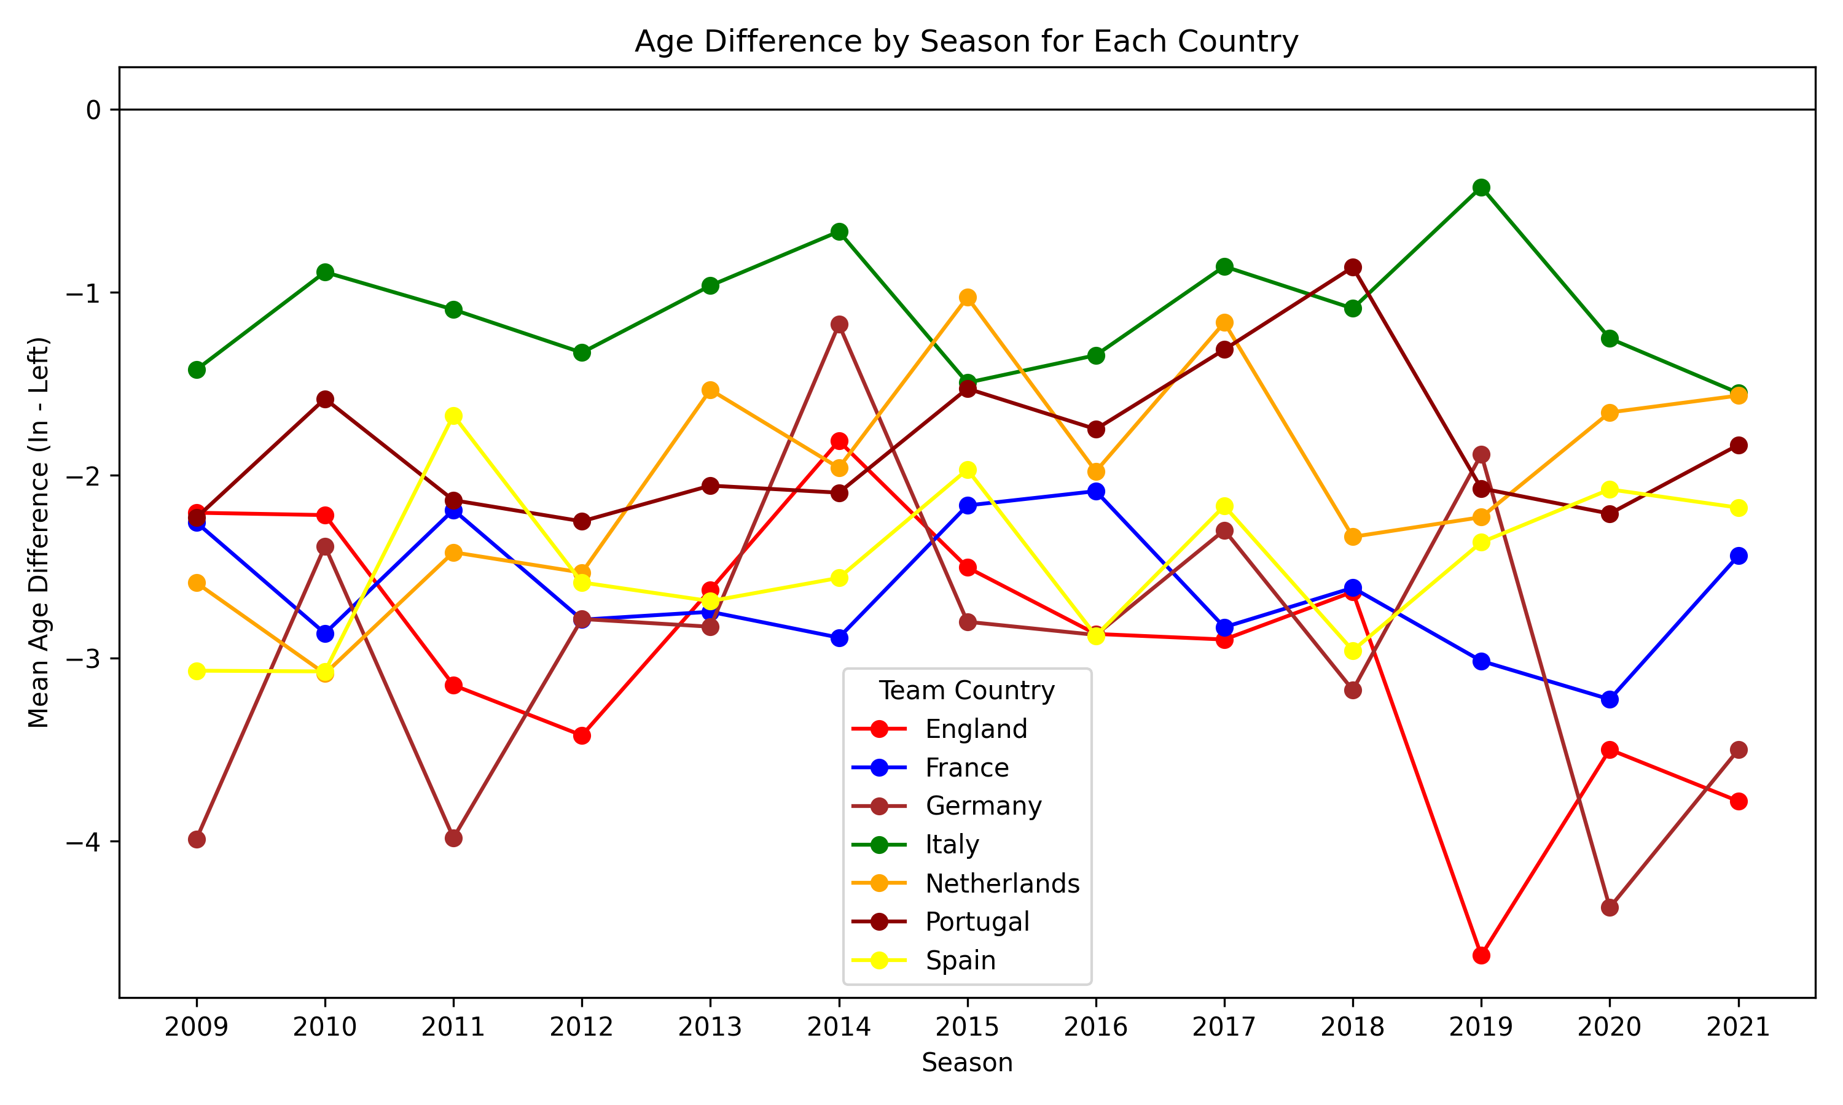
The Football business
Age of players

Slide 21
The Football business
Final Table

Slide 22
The Football business
Conclusion

